Slide 1
Research Paper Presentation of COOP-II
On
Synergistic Approach to Automated Plant Disease Diagnosis
By
Shivanshu(2210992329),Suraj Veer(2210990878)
Supervised By
Dr. Ajay Kumar
Department of Computer Science and Engineering,
Chitkara University, Punjab

Slide 2
INTRODUCTION
Why Plant Disease Detection More Than Accuracy
Growing Role of AI:
Machine learning is increasingly used in agriculture for disease detection,crop monitoring and yield improvement.Early identification of plant diseases is essential to prevent large-scale losses.
Accessibility Matters:
Traditional methods rely on expert knowledge and manual inspection, which are not easily available to farmers in rural areas.AI-based systems can provide instant and accessible diagnosis.
Accuracy Is Not Enough:
High accuracy alone is not sufficient. The system must be fast, reliable, and usable in real-world conditions, especially for non-technical users.

Slide 3
PROBLEM STATEMENT
Most existing research in plant disease detection focuses mainly on improving model accuracy, but this is only one aspect of a complete real-world solution.
Many models are developed and evaluated in controlled environments, without considering practical usability and deployment challenges faced by farmers.
Object detection approaches like YOLO require bounding box annotations, which are not always available in datasets such as PlantVillage, making them difficult to apply effectively.
High-performing models often come with large computational requirements, limiting their use on low-resource devices commonly used in agricultural settings.
Additionally, there is a lack of systems that integrate prediction with actionable insights, such as treatment recommendations, which are essential for practical decision-making.

Slide 4
OBJECTIVE
What this study aims to achieve?
Build and compare different deep learning approaches (YOLO vs EfficientNet).
Develop an accurate plant disease classification model.
Achieve a balance between accuracy and efficiency.
Create a system that is suitable for real-world usage.
SOLUTION
Develop a complete deep learning pipeline for plant disease detection.
Use EfficientNet-B0 with transfer learning for classification.
Train on PlantVillage dataset (54,000+ images).
Deploy the model using FastAPI backend.
Build a web interface for image upload and prediction.
Provide confidence score and treatment suggestions.

Slide 5
METHEDOLOGY
RESEARCH FRAMEWORK AND APPROACH
1. Data Preparation:
PlantVillage dataset used (54,305 images, 38 classes).
2. Model Selection:
Initial approach with YOLO (object detection). Switched to EfficientNet-B0 (classification) for better performance.
3. Model Training:
Transfer learning with pre-trained ImageNet weights. Training limited to 5 epochs.
4. Performance Evaluation:
Metrics used: Accuracy and Loss. Validation performed after each epoch.
5. Deployment:
Model integrated using FastAPI backend. Web interface developed for real-time predictions.
….

Slide 6
RESULTS
Model Performance and Observations:
Model Comparison:
EfficientNet-B0 performed better than other architectures in terms of accuracy-to-efficiency trade-off.
Model | Parameters | Accuracy
VGG16 | 138.4 M | 92.0%
ResNet-50 | 25.6 M | 93.0%
MobileNetV2 | 3.4 M | 93.0%
EfficientNet-B0 | 5.3 M | 93.1%

Slide 7
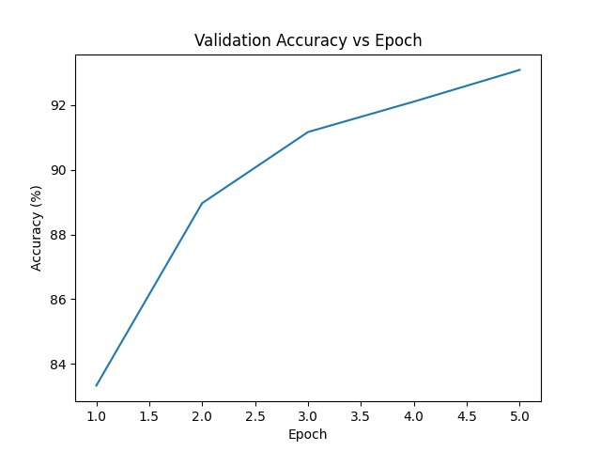
RESULTS
Accuracy Achieved:
EfficientNet-B0 achieved 93.1% validation accuracy within 5 epochs.

Slide 8
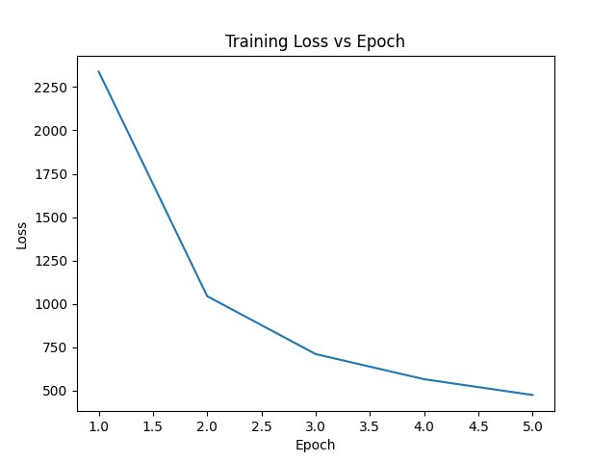
RESULTS
Loss Behavior:
Training loss showed a sharp decrease initially, followed by gradual convergence.

Slide 9
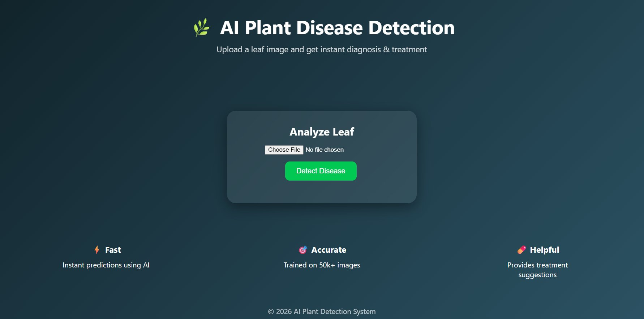
RESULTS
Model Output :

Slide 10
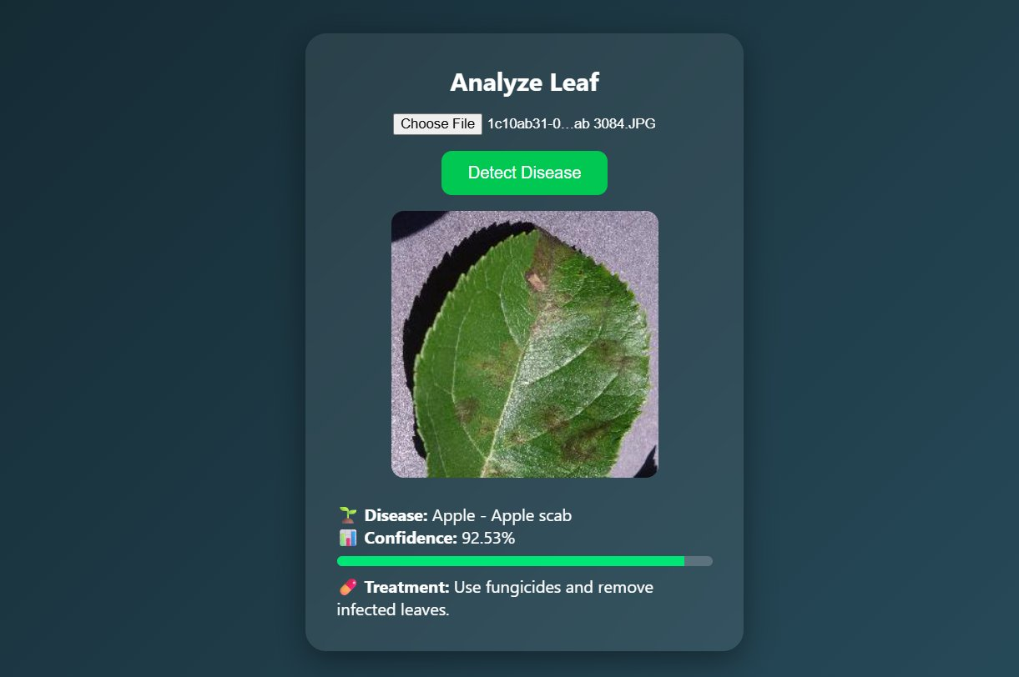
RESULTS
Displays predicted disease label
Shows confidence score
Provides treatment suggestion

Slide 11
CONCLUSIONS
EfficientNet-B0 achieved 93.1% accuracy within 5 epochs, showing fast convergence.
The model demonstrated a good balance between accuracy and efficiency.
The system was successfully deployed using FastAPI with a web interface.
Overall, the model provides a practical and real-time solution for plant disease detection.
FUTURE WORK
Train the model for more epochs to improve accuracy further.
Deploy the system on mobile devices for wider accessibility.
Expand to support more crops and disease types.
Improve robustness for complex backgrounds and lighting conditions.

